Slide 1
Lecture 04 – Logic circuits
2017.08.28 Dr. McCoy: Mr. Spock, remind me to tell you that I'm sick and tired of your logic.
Spock: That is a most illogical attitude.

Slide 2
Announcement
My office hours posted
Will stay in MATH 175 between lectures
Homweork 01 now due Thursday, 8/31

Slide 3
Assignment for Week 02
Register your iClicker
Helpful conversations taking place on Piazza
Lab 01 this week
HW 01 now due Thursday, Aug. 31
Finish textbook chapters 1 and 2, read chapters 4 and 5 next (will come back to chapter 3 later)
Notes:
15 clickers recorded, but without associated student name

Slide 4
Voltage and current, part 1
Kirchhoff’s electrical circuit behavior laws
Voltage Law: the sum of voltages, V, across the devices around a closed circuit is zero
Current Law: the sum of currents, I, entering and leaving a point in a circuit is zero (electrons neither accumulate nor deplete)
Details of sign convention for voltage and current
Electrons gaining energy move from – to + device terminals by convention, loosing energy is + to –
Current flow into a point in a circuit is positive, leaving a point is negative

Slide 5
Voltage and current, part 2
Ohm’s Law: the voltage measured between two points in a circuit is proportional to the product of the current flowing between those two points and the total resistance between those two points V = I x R units are volts = amperes x ohms

Slide 6
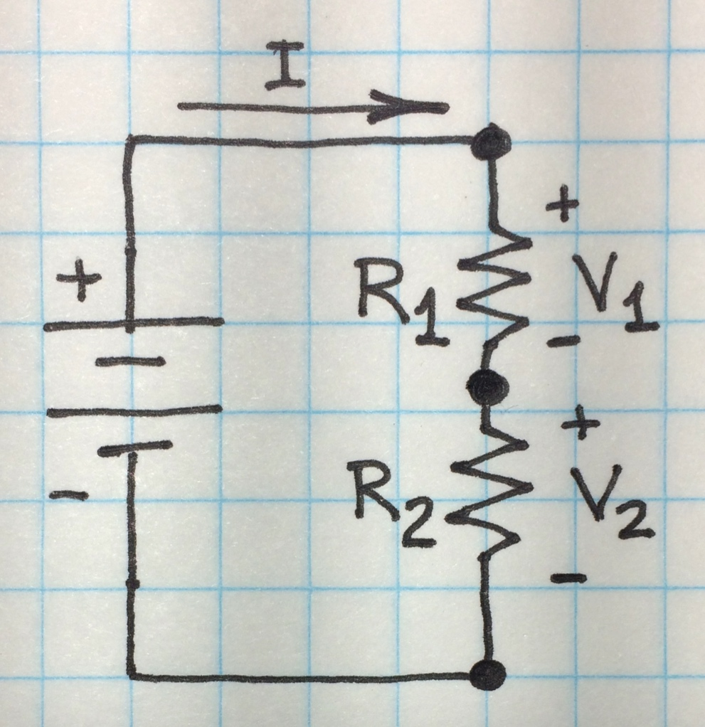
Example circuit
Circuit with battery driving two resistors in series
V volts of energy gain from battery; V₁ and V₂ volts of energy loss from resistors, respectively
Resistors of values R₁ and R₂ ohms
Current I around the circuit
V

Slide 7
Example circuit with supply voltage V
By Kirchhoff’s Voltage Law V + V₁+ V₂ = 0 or V = V₁+ V₂
By Kirchhoff’s Current Law, I, must flow through resistors R₁ and R₂ equally
Ohm’s Law says voltage from Output to Ground I = V₂/R₂ and voltage from High to Ground I = V/(R₁+ R₂)
thus Output voltage V₂ is V₂= V(R₂/(R₁+ R₂))
High
V
Output
Ground

Slide 8
Creating two voltage levels
Key idea is a two-resistor “voltage divider”
Because V(R₂/(R₁+ R₂)) = V₂
Obtain two near-ideal V₂ levels of +V and Ground via two extreme cases:
Build R₂ << R₁ V(R₂/(R₁+ R₂) ≐ Vx0 = 0 = V₂
Build R₂ >> R₁ V(R₂/(R₁+ R₂) ≐ Vx1 = V = V₂
Output is a circuit node with desired two digital voltage levels
High
V
Output
Ground
8
Notes:
Just two resistors and, presto, digital logic.
It’s called hardware, but really it’s easyware!

Slide 9
A switch is a two-valued resistor
Open (not connected) switch presents very high resistance to the flow of electricity
Closed (connected) switch presents a very low resistance to the flow of electricity
Switch implementation examples
Wall switch: mechanical “signal” controls switch on/off condition
MOSFET: electrical signal controls on/off

Slide 10
Series and parallel resistors
Total resistance of resistors in series is the sum of the resistances: R_{T} = R₁+R₂+ … +R_{n}
Low R_{T} requires all resistors of low value
Total resistance of resistors in parallel is 1/R_{T} = 1/R₁ + 1/R₂ + … + 1/R_{n}
Any one resistor low is sufficient for low R_{T}
…
R₁
R₂
R_{n}
R₁
R₂
…
R_{n}

Slide 11
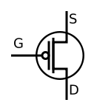
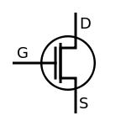
NAND circuit is a voltage divider
+V voltage
High
Parallel
resistors
A
B
V
Out
Output
A
Series
resistors
B
Ground
11
11
0 volts

Slide 12
Digital Logic
Built on a system of two values; those values can be interpreted as
Positive voltage and zero volts (ground)
High and low
True and false
Asserted and not asserted
Underneath it’s all analog and in our case wires, devices, and electrons

Slide 13


Abstraction
Digital logic behavior, a joy to behold,
but paddling like hell underneath
to make it happen.

Slide 14
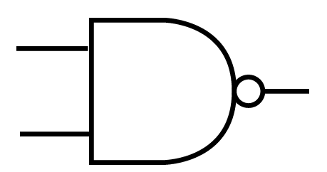
Diagram levels of abstraction
+V voltage
Gate symbol – shows no circuit detail
A
B
Out
A
B
0 volts
More abstract representation

Slide 15
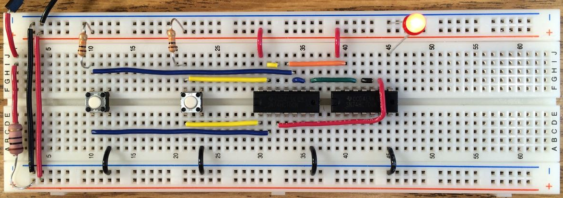
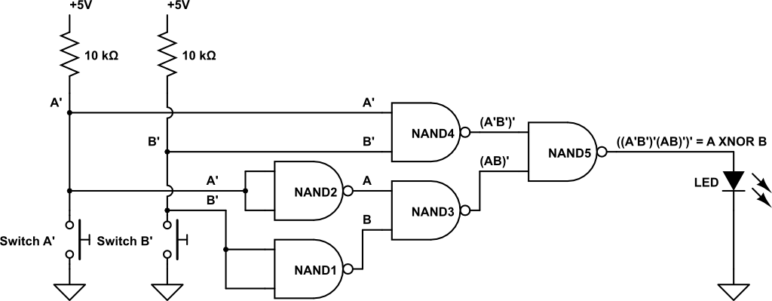
Levels of abstraction
More abstract representation

Slide 16
Comparison of HW gates and SW
How do hardware (HW) and software (SW) behave?
Initialization
SW: declarations; translate from source to machine code
HW: turn on the power supply
Acceptance of input
SW accepts input when commanded and as specified double b[SIZE]; fp = fopen("test.bin","rb"); size_t ret_code = fread(b, sizeof *b, SIZE, fp) // reads an array of doubles
HW, when ON, continuously accepts (reads) inputs
HW reads binary values only

Slide 17
Comparison of HW gates and SW
Functionality
SW: Decided at any time; basically limitless; some programs have long running times
HW: Fixed in advance; limited to a few choices; execution time measured in 10⁻¹⁰ second intervals
Output
SW: can be complex, formatted, any symbols
HW: voltages on wires, denoting only bits

Slide 18
Summary
We build digital circuits from Complementary MOSFET transistors, called CMOS for short
Voltage divider style circuit is the basis for two-level digital logic circuits
Boolean algebra describes operations on set with two elements, basis for describing the logic we use in electronic computers
Powered HW is always active; loaded SW may be suspended rather than executing

Slide 19
Summary
Automating computing means using a machine
Using machines to compute depends on finite symbol sets
In an analog world, error accumulates
We can make machines that behave digitally
Finite symbol sets match manufacturing capability
Easy symbol distinguishability reduces errors
Key concepts to achieve the above
Binary (and higher-radix) number systems
Voltage band for each symbol and voltage gaps between each pair of symbols for error resistance

